Slide 1

amble
Midway Milestone - A8
Frieda R., Kelsey Z, Rickenson R., Thomas E.

Slide 2






Overview
PROBLEM & SOLUTION
VALUE PROPOSITION
VALUES ENCODED
HEURISTICS
USABILITY GOALS & MEASUREMENTS
INTERFACE RE-DESIGN
PROTOTYPE OVERVIEW

Slide 3

How might we motivate people to learn and pursue creative activities in a way that utilizes their existing interests?
With the abundance of distractions and resources in our daily lives, it can be challenging to feel motivated in exploring hobbies and creative outlets.

Slide 4
GIVE YOUR CREATIVE CURIOSITIES SOME DIRECTION!
Many people struggle with choice paralysis when it comes to starting and finishing creative tasks. Amble provides direction by giving users a customized roadmap to achieve their artistic goals and explore curiosities without the pressure of expectations.

Slide 5
Values
Within our platform, we aim to encode the values of efficiency, learnability, and inclusivity for users. As we build amble, our goal is to embed these values through an understanding of our users and the context in which amble will be used.
Efficient design for users to easily and logically navigate
Learnable elements and content
Inclusive platform that caters to a diverse audience

Slide 6
Usability Goals & Key Measurements
We focus on discovering how efficient, learnable, and inclusive our platform is for users.
Learnability: judged the speed and amount that users improved their navigation of the platform when asked to do perform each task
Efficiency: judged as how easily users were able to complete a task without confusion or questions
Inclusivity: measured how naturally users felt they were able to do a task regardless of their skill level with using technology and ability to learn

Slide 7
Heuristic Evaluation Results
1-2 Severity: 17 11 changes
3-4 Severity: 14 10 changes

Slide 8
Overall, feedback was generally positive in regards to the logical navigation and interactivity between tasks, particularly with the minimalistic and sleek design of our app.
Our statistics showed 17 violations within the 1-2 severity levels. Though some were due to figma limitations, we so far have planned and begun to implement 11 of the 1-2 sev. violation solutions through our re-design process.
Most violated heuristics: visibility of status (4), consistency (6), accessible (5)

Slide 9
3-4 Severity:
14 10 changes

Slide 10
Issue 1: H2, Sev 4
In the interface for “Suggested”, the “Based on your history…” graph is difficult to understand: it’s unclear what it is showing and what the axes mean. It is also unclear why the users would want to see this in the first place.
Providing clear suggestions is an essential component to amble’s personalized and curated experience, yet our elements did not show this.

Slide 11
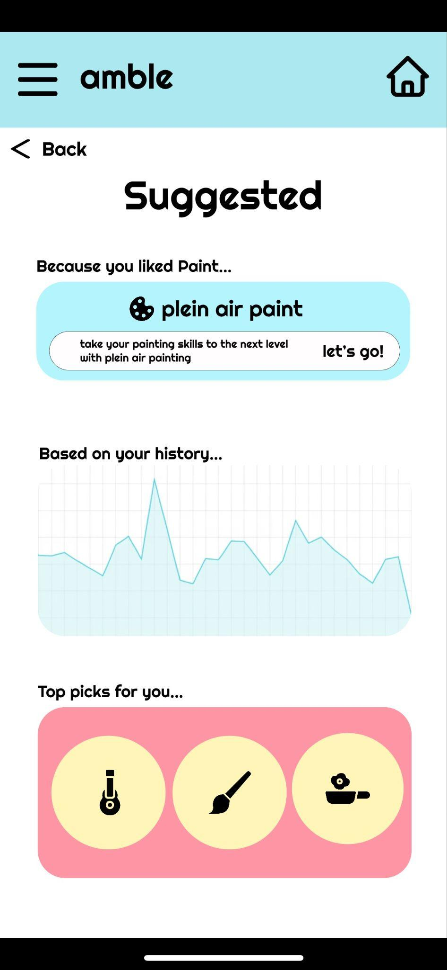
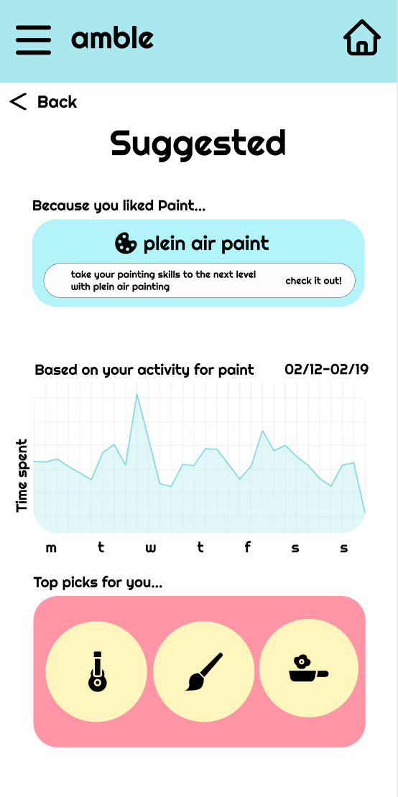
Revision 1:
Fix: Label the graph with a title and the axess. Reconsider the how the information is displayed, possibly as a list of information rather than a graph

Slide 12
Issue 2: H3, Sev 4
No obvious way to remove a tutorial/activity/note from a profile. Hard to know whether or not things can be deleted. I.e. if I accidentally clicked Plein Air Paint and decided I didn’t actually want to do it, how could I remove it from my profile?
Allowing users to add and delete bytes is a key feature of usability.

Slide 13
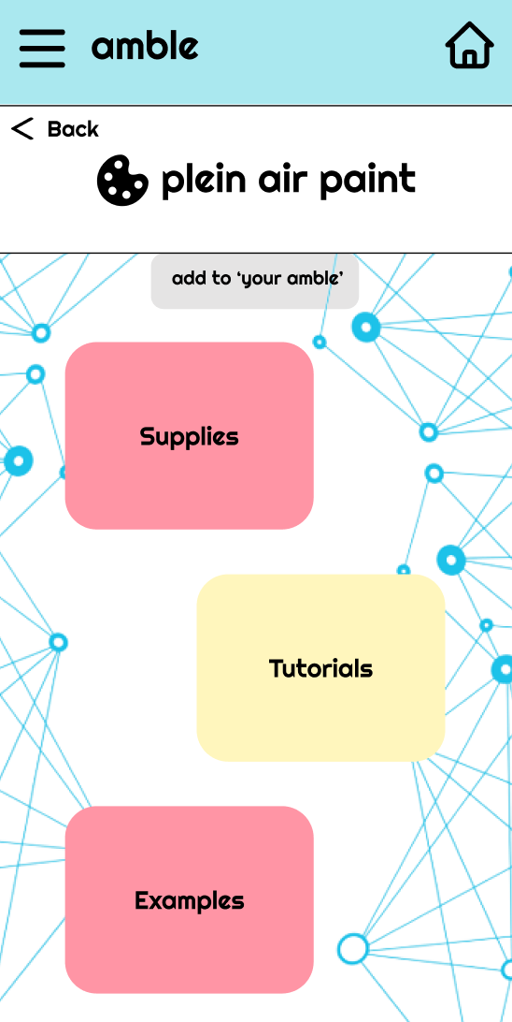
Revision 2:
Fix: Add a simple ‘cancel’, or ‘quit’ button on the initial page of a new task. Add a ‘remove byte’ feature to the homescreen and profile

Slide 14
Issue 3: H6, Sev 4
In the interface for viewing “Tutorials”, the screen is quite cluttered. It’s unclear what each of the yellow sections are supposed to represent
It’s important for the purpose of the tutorials page to be easy to understand and usable. (Part of the lack of clarity is due to figma and implementation limitations)

Slide 15
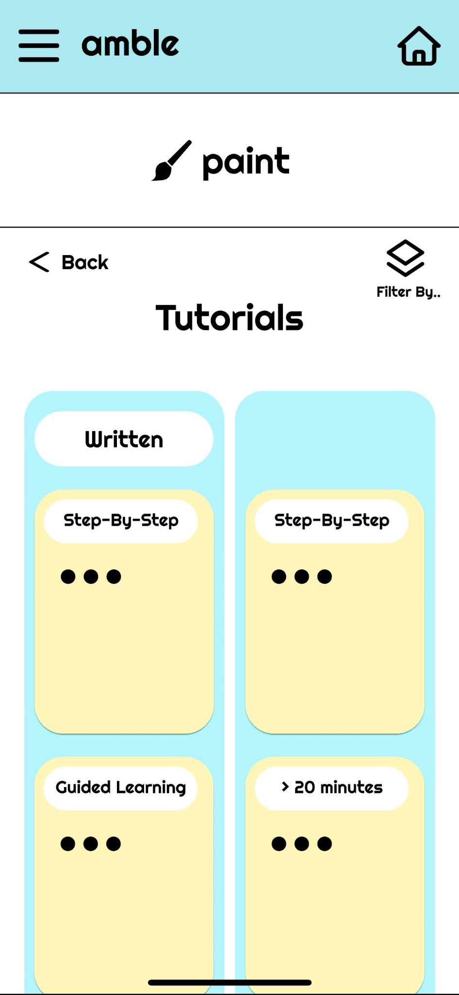
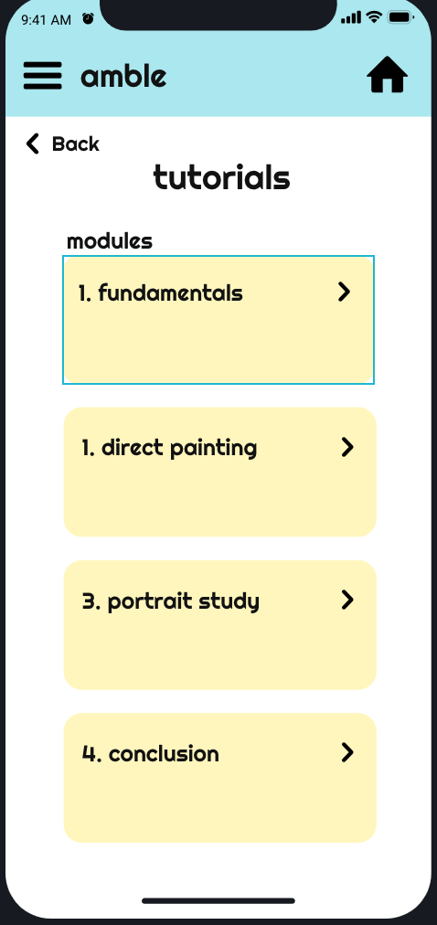
Revision 3:
Fix: Making the “Tutorials” interface one horizontal block rather than a split design. The written vs. video format will be put into the filter feature

Slide 16
Issue 4: H10, Sev 3
As of now, the only help included in the prototype is the ‘Start here’ indicator. There is no ‘help’ tab or ‘info’ button on any pages to indicate how a user should go about navigating a task, adding a task, or exploring a new area.
The user should have a place to find helpful resources and tips on how to use the app. Users shouldn’t have any difficulty knowing how to navigate and use the app.

Slide 17
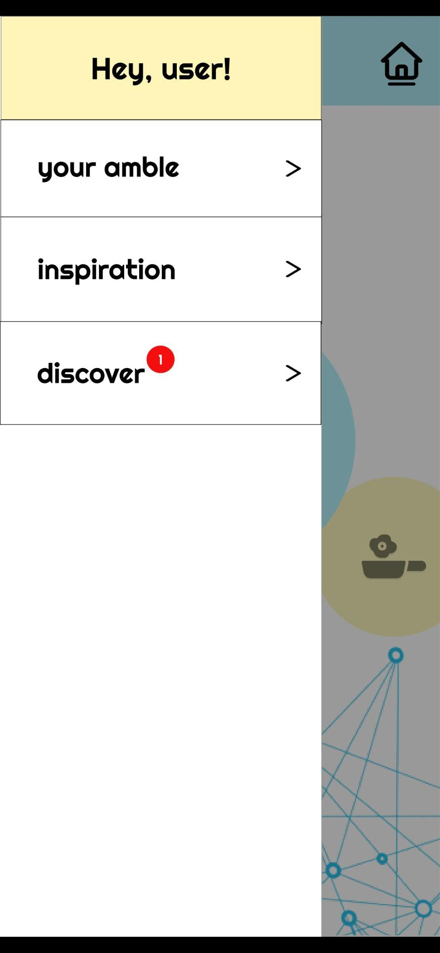
Revision 4:
Fix: Add a ‘help’ tab in the drop down menu with FAQs or a short tutorial for new users

Slide 18
Issue 5: H11, Sev 3
No obvious alternative presentation of options/usability yet. There is a ‘your amble’ tab where accessibility settings could go, but as of yet it is not interactive in the prototype.
The app should cater to a diverse audience and accommodate various types of users. Users should have the ability to change their settings to make features usable for them.

Slide 19
Revision 5:
Fix: Include options in the settings to dictate buttons/screens, and an option to increase text size or change visibility settings (lots of this may in fact be covered by the users phone settings)

Slide 20
Hi-Fi Prototype Status

Slide 21
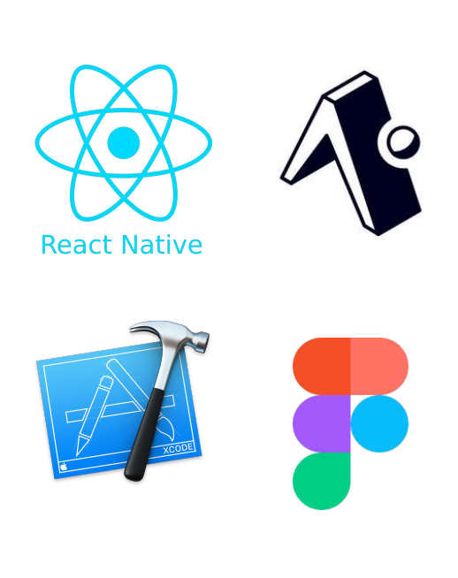

Tools & Resources Used
- React Native (application framework)
- Expo (building and simulation)
- BuilderX (react component builder)
- Figma (for design components)

Slide 22
Implemented Features
Home-screen
Navigation option (slide out drawer)
Ability to navigate b/w dummy pages
Note-taking section

Slide 23
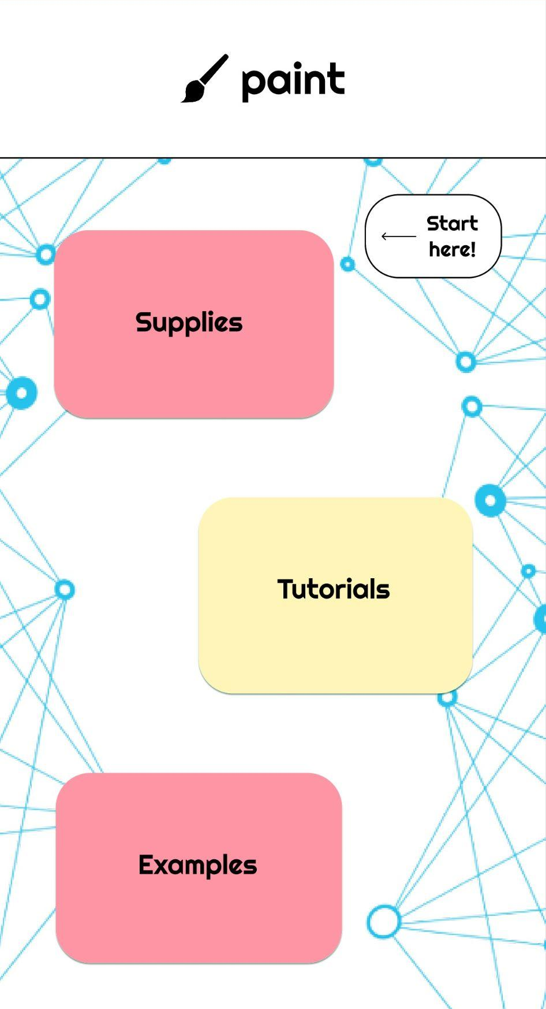
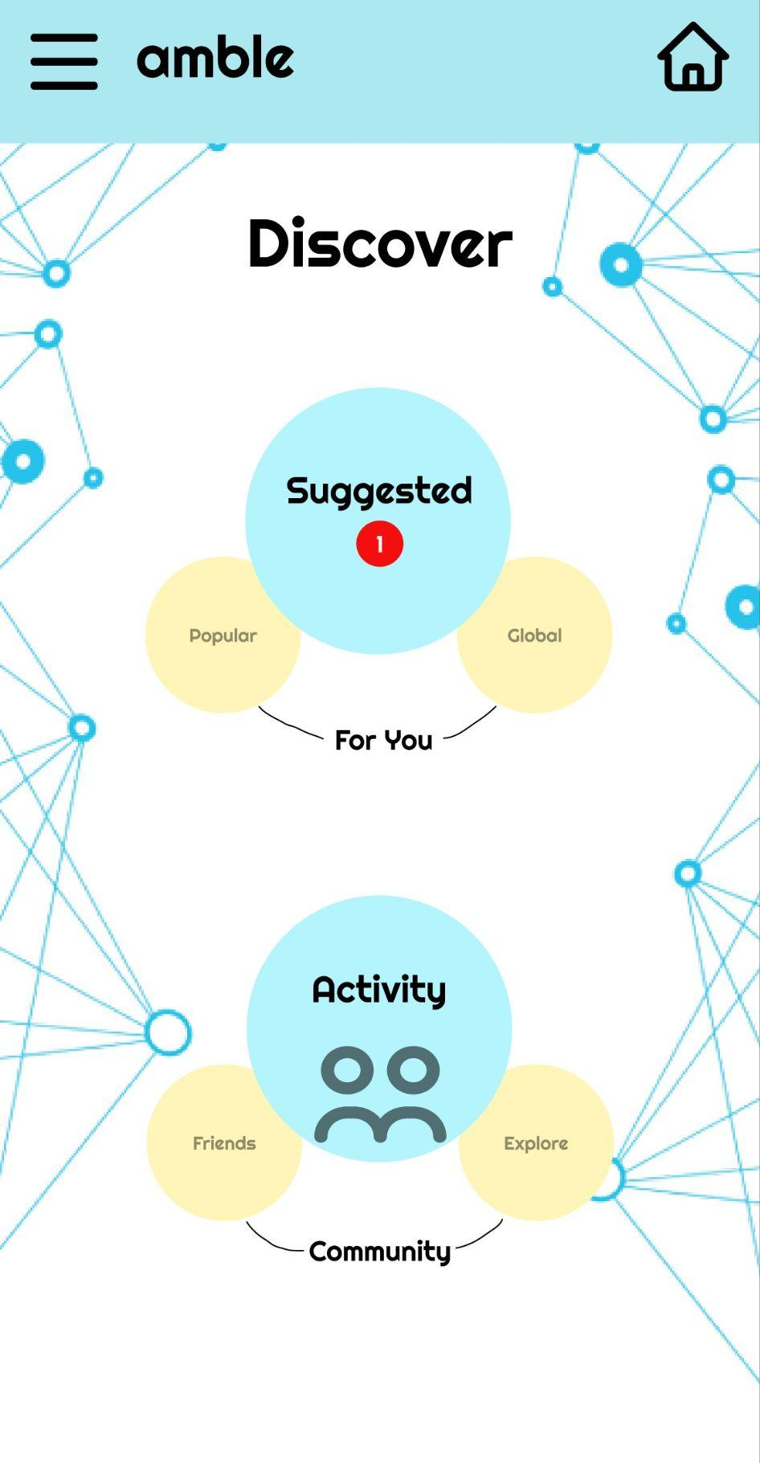
Unimplemented Features
Carousel sliding feature for home-screen
Discover page
Suggested bytes
Tutorials page

Slide 24
Our Plan
Interactions b/w screens
Scrolling features
Buttons and graphics for task 2
Tutorials
Help feature with walkthrough tutorial on how to use the app
Suggested page
User history features
Aesthetic changes and touch-ups

Slide 25
Hard-Coded Features
Tutorials provided to the user
Graphics and flaticons
Recommended bytes to user

Slide 26
Prototype Overview: Wizard of Oz
Future designs of our app would incorporate
image-recognition feature using trained algorithm
tutorials that would need additional work to source and determine copyrights onto the platform
These features may not be feasible in a 10-week frame.

Slide 27

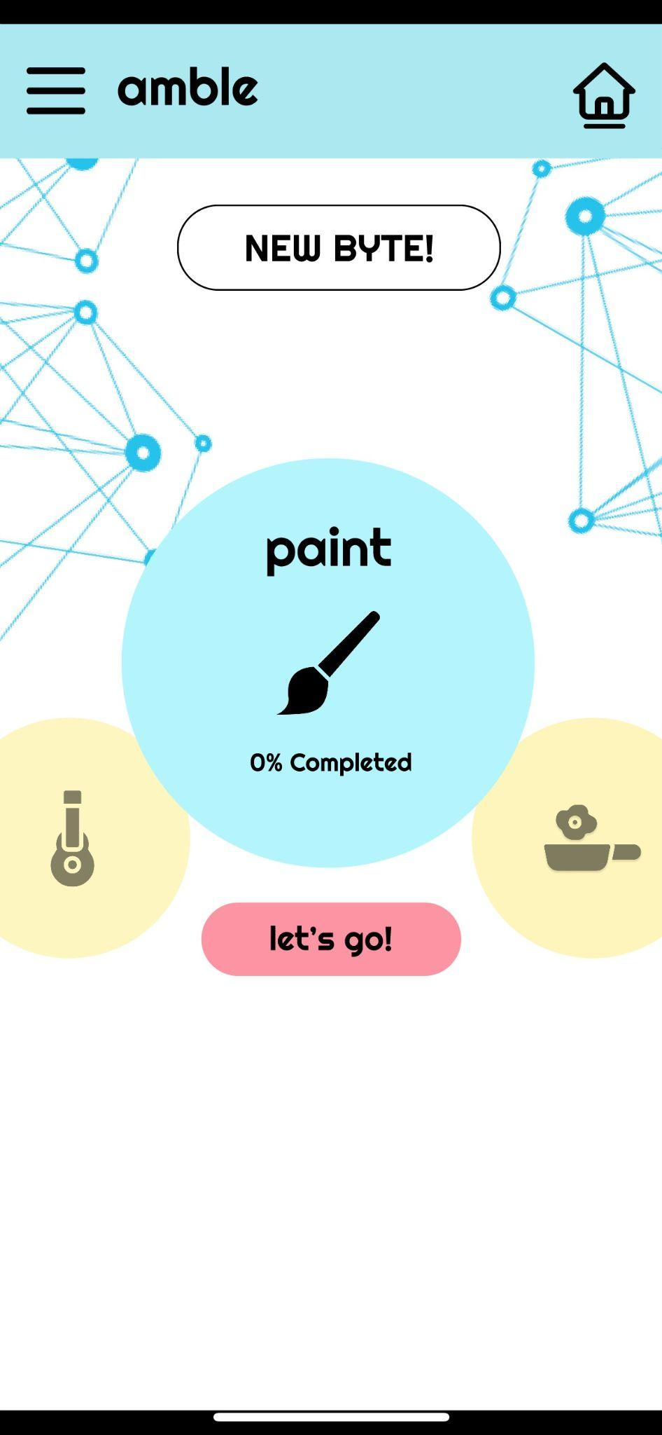
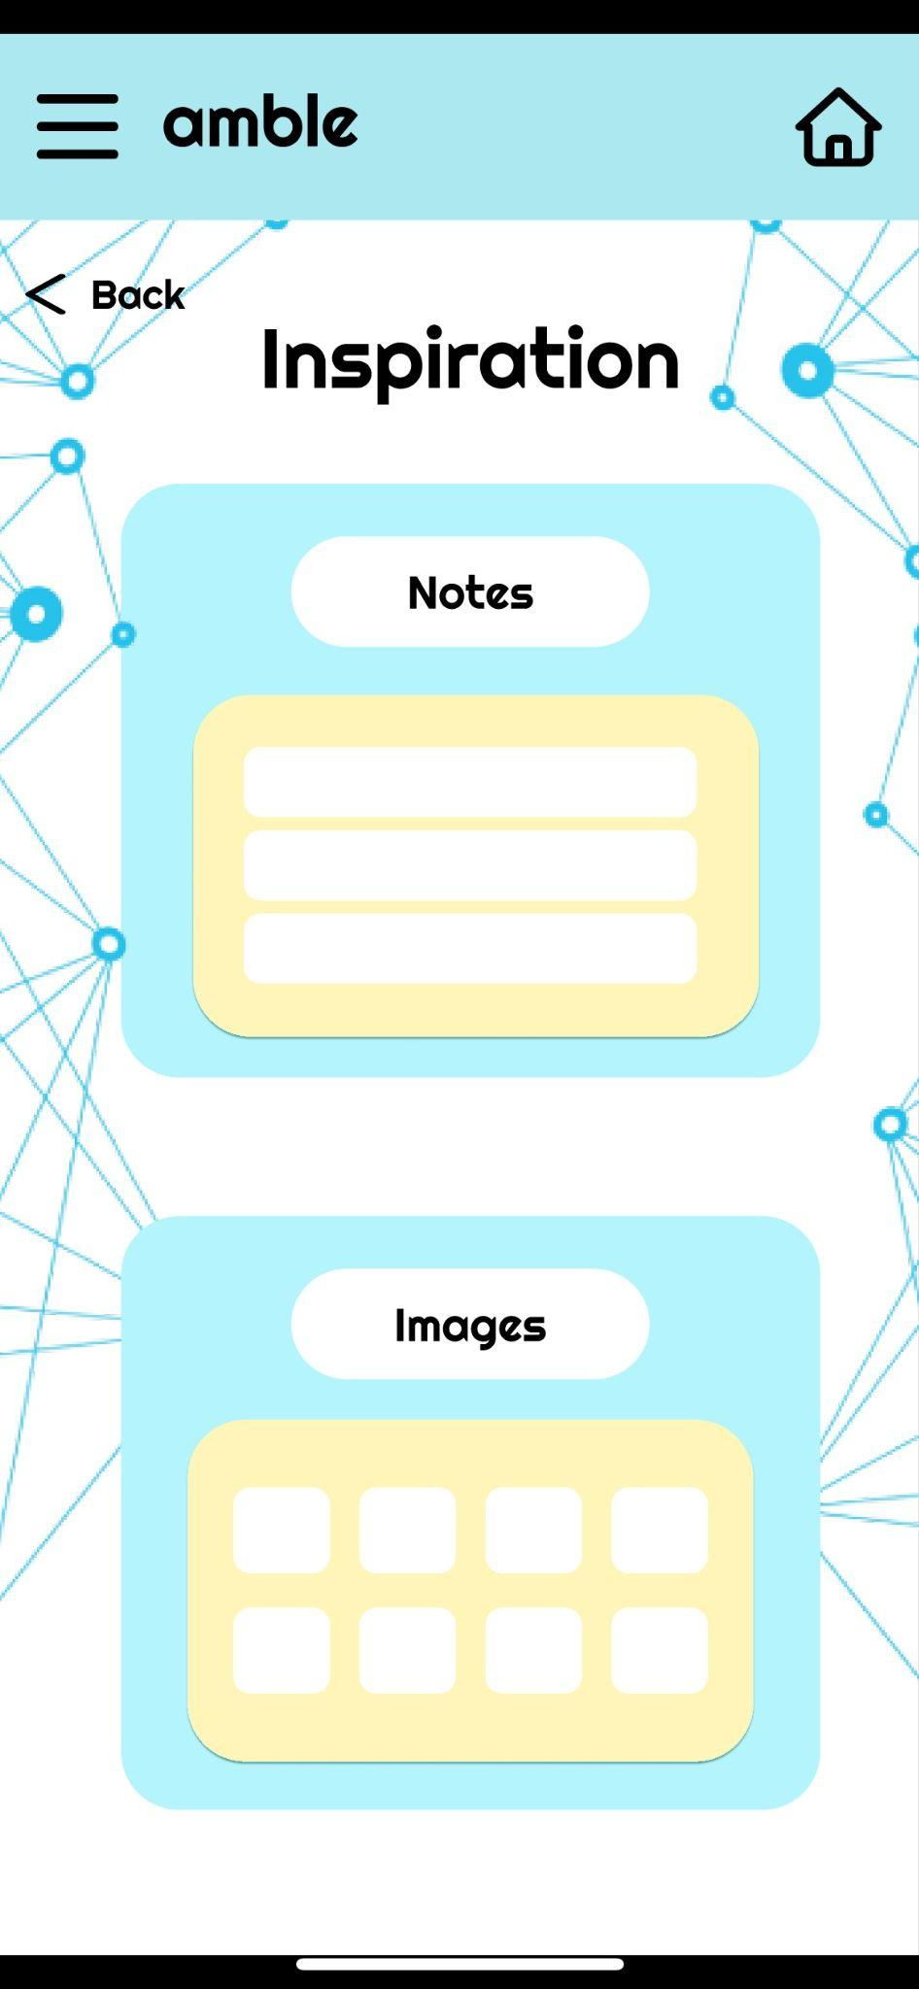
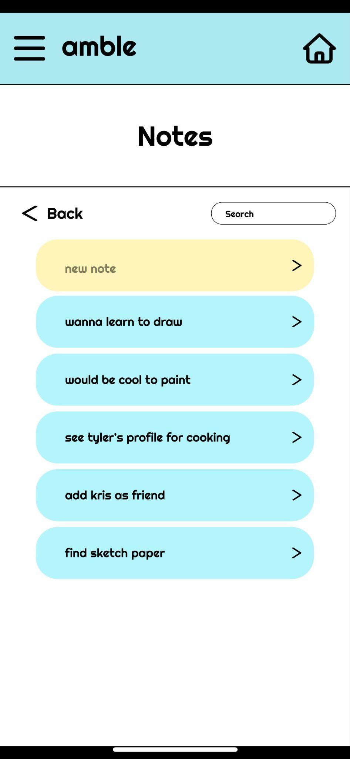
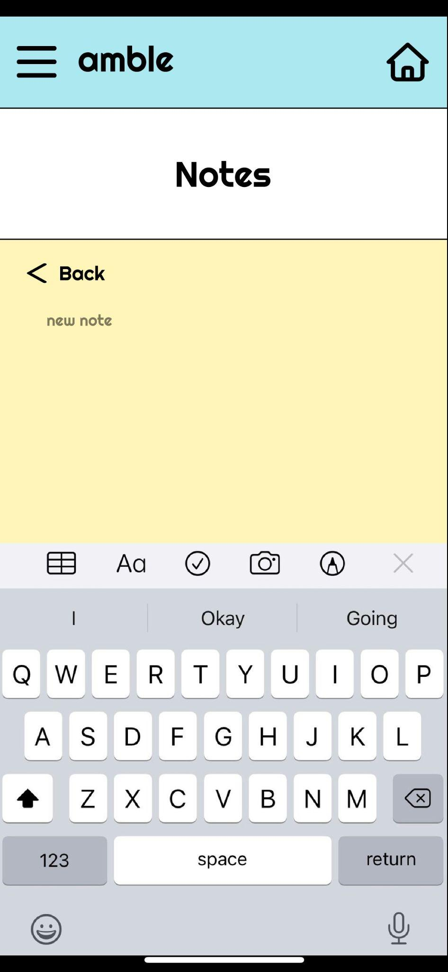
Prototype - Task 1 Flow
Loading screen
Home screen - find notes area
Menu bar
Inspiration screen
Notes page
Make a new note screen

Slide 28
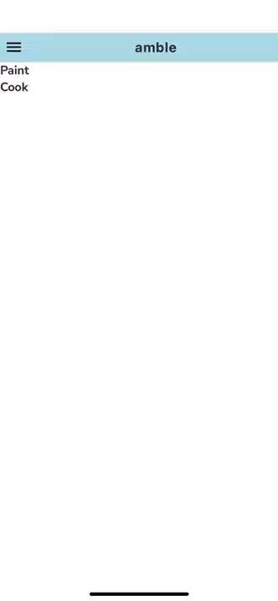
Prototype Demonstration:

